Slide 1

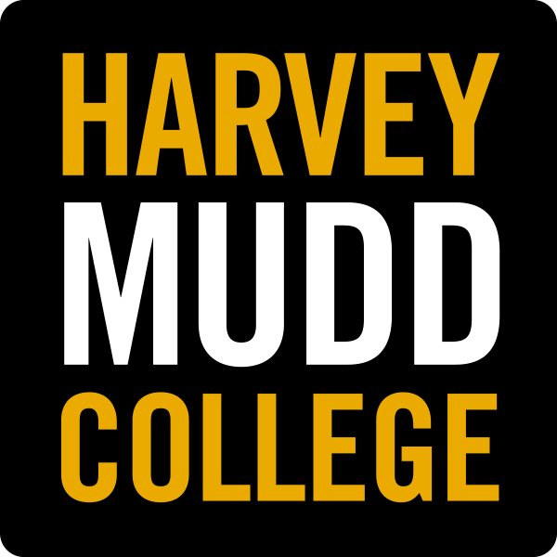
Lab 2 – Line Following
MIT Beaver Works Racecar Curriculum
https://matthewcalligaro.github.io/RacecarWebsite/

Slide 2
Lab Objectives
Main objective: Program the car to track a line and turn based on its position
Learning objectives
Use the start-update paradigm to create a program which can run on the car
Use the camera module to identify the line
Program the car to follow the line

Slide 3
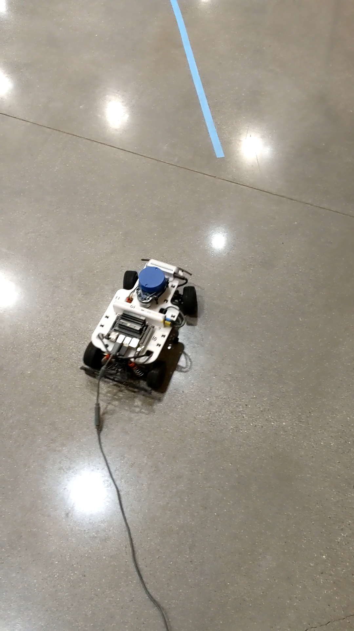
Lab 2 Demo

Slide 4
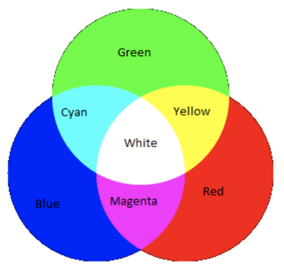
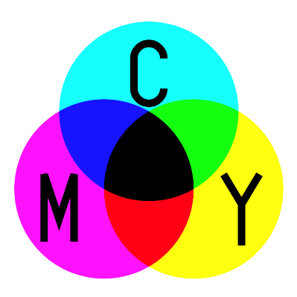
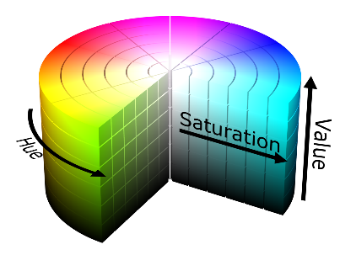
Color Space
Color models map input values to colors.
Color space is the range of colors a color model covers.
RGB models use measurements of red, green, and blue
RGB
CMYK
HSV

Slide 5
HSV
Hue Which color?
Saturation How vibrant?
Value How dark or light?

Slide 6
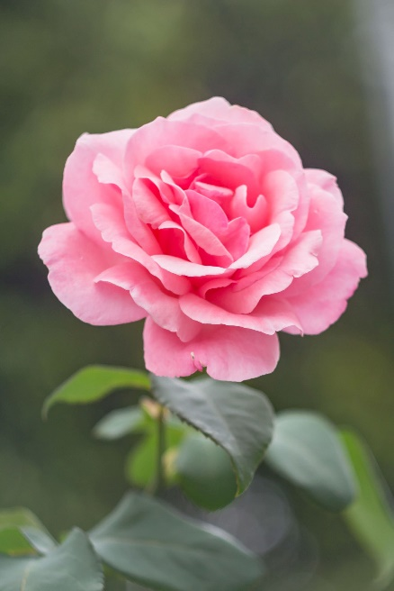
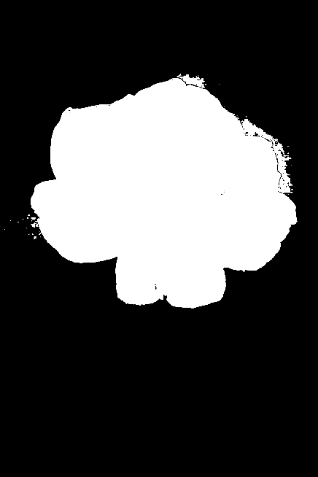
OpenCV Masks
Using a color threshold, we can make masks from images.
BLACK out what you want to be hidden
WHITE out what you want to be seen

Slide 7
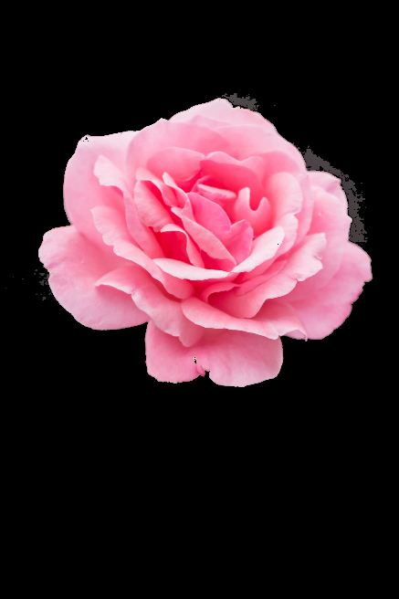
Color Masking
Combine the color image with the black and white mask to make a color mask.

Slide 8
Color Masking
White Mask
Full color
Black Mask
No color
Color masks can be made with any black and white mask.

Slide 9
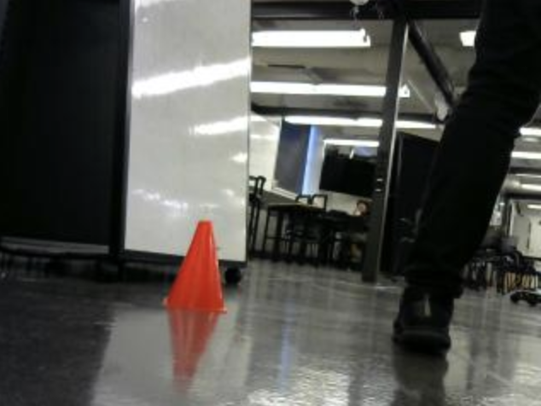
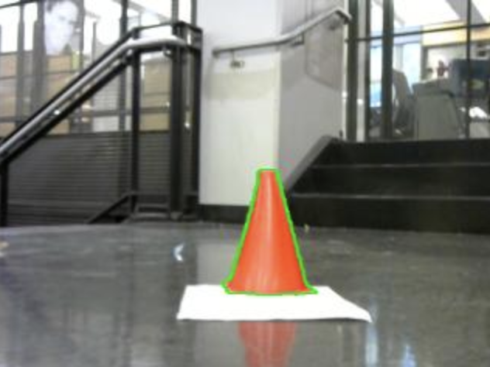
Contour Drawing
With color masks, we can identify objects and create contour drawings.

Slide 10
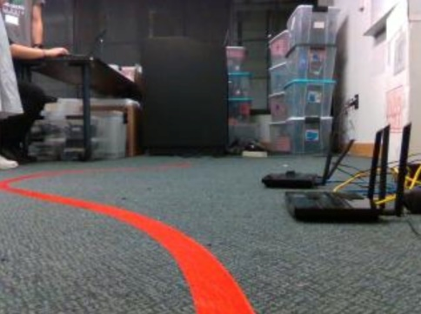
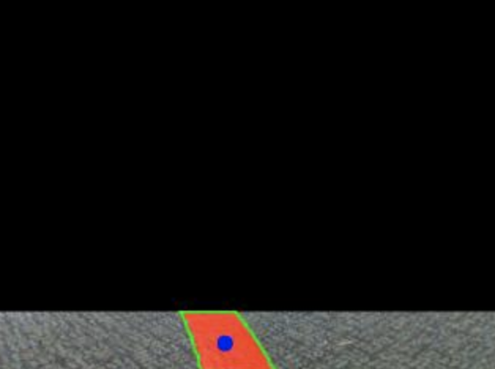
Line Identification
Steps of Line Identification
Crop image
Color mask
Object identify
Contour drawing
Pick largest contour
Take center of largest contour
Initial image
Final product

Slide 11
Navigation
You will be responsible for programming your car to turn left or right based on relation between the center of the line contour and the center of the car.

Slide 12
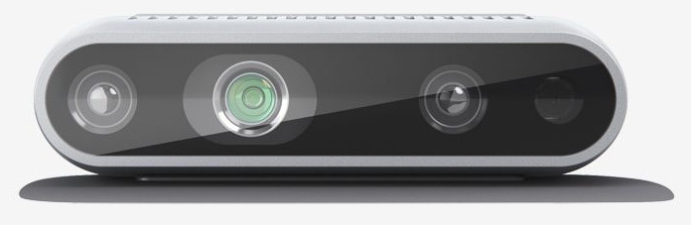
Camera Offset
The Intel Realsense camera will be used to capture images. However, the camera is offset from the center of the car.
Offset

Slide 13
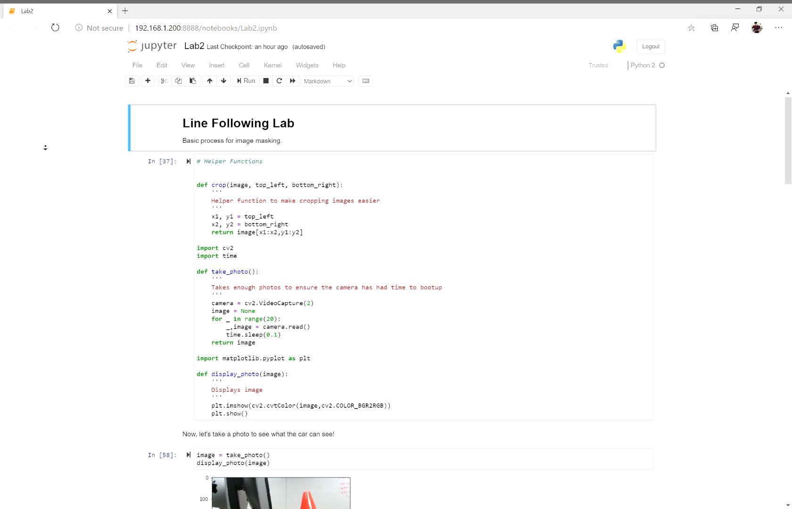
Jupyter Notebook

Slide 14
Good luck and have fun!
Let us know if you need any help during the lab

